Slide 1


Slide 2
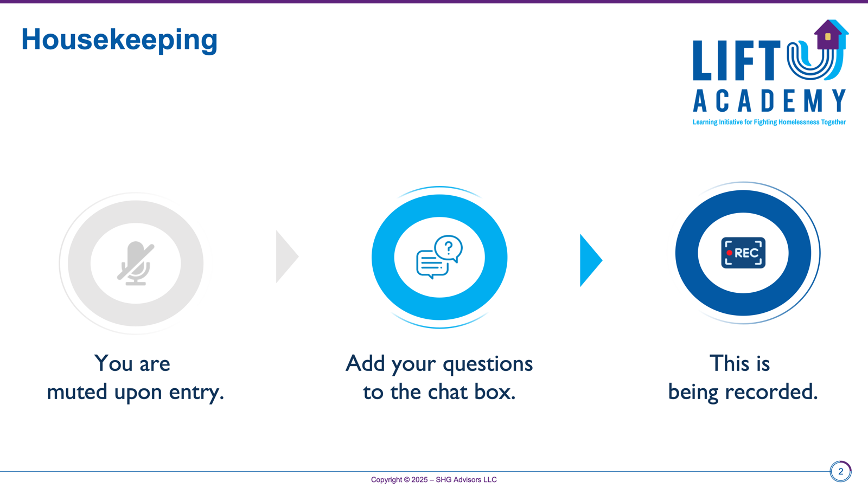

Slide 3
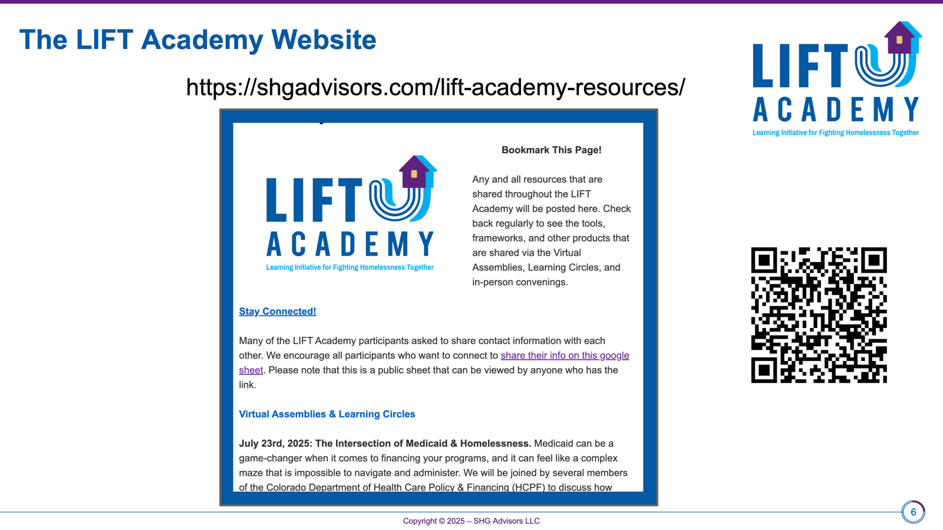

Slide 4

Motivational Interviewing brief training Lift Academy December 16, 2025
Linda Abadjian, PhD
NBC-HWC, ICF-ACC

Slide 5
Good morning Gratitude: Grateful for small things, big things and everything in between
Notes:
intro

Slide 6
WHAT is MI? Motivational Interviewing (MI) is an evidence-based technique, a collaborative, client-centered counseling style that helps people find their own reasons and commitment to change behavior by exploring and resolving their mixed feelings (ambivalence) about it.

Slide 7
Where does MI fit? MI has traditionally been used across healthcare, mental health, social work, criminal justice and in creating cohesive working environments

Slide 8
MI is REAL Respect Empathy Active Listening

Slide 9
Agenda
Introduction to Motivational Interviewing
Theory/Ideas on Change
Communication
Key Concepts
Principles of MI
Four Tasks
Strategies & Skills
Guiding Principles
Questions

Slide 10
Brief History of MI – 1st edition: 1991, latest 4th edition: 2023
William (Bill) Miller
began his career with substance use disorder
influenced by Carl Roger’s Person Centered-Humanistic therapy
observed that arguing for change created more defenses for maintaining the status quo
Steve Rollnick
began his career in addiction/difficult behavior change
reviewed one of Bill’s first papers
views MI as offering “helpfulness”

Slide 11
Theory on Change Prochaska and DiClemente’s Stages of Change
Precontemplation
Contemplation
Preparation
Action
Maintenance
Termination - Relapse - Repeat

Slide 12
Thoughts on Change
“Things Do Not Change-We Change” -Henry David Thoreau
“People possess substantial personal expertise and wisdom regarding themselves, and tend to develop in a positive directions, given the proper conditions and support…”
-Miller & Moyers ’06
“With MI, when we meet people considering change, we meet them where they are at.” LA

Slide 13
Communication:
Definition: the imparting or exchanging of information or news
Foundation: deep listening
Types: verbal, non-verbal, visual & written

Slide 14

COMMUNICATION STYLES
Directing-----Guiding-----Following
administer collaborate allow
decide elicit be with
determine encourage attend
lead inspire listen
manage look after observe
prescribe motivate stay with
steer offer understand
take charge support value
MI uses all

Slide 15
Motivational Interviewing gives insight on how to BE with a person, as they navigate what changes they want and how to make those changes.
Even before we jump into the techniques it is important to honor each person, just as they are
With this foundation, MI offers several values, style & spirit, principles and tasks

Slide 16
Key Concepts of MI
Acceptance
Autonomy
Compassion
Directing
Empowerment
Following
Guiding
Partnership
Person Centered
Spirit of MI

Slide 17
ACCEPTANCE
When a person feels accepted for who they are and what they do-no matter how unhealthy or destructive – it allows them the freedom to consider change rather than needing to resist it

Slide 18
SPIRIT OF MI
Collaborative
Eliciting
Empathic
Helpful
Individualized
Non-judgmental
Positive
Present
Respectful
Warm & friendly

Slide 19

Principles of MI - RULE
R- Resist the righting reflex (resist directing “NO FIXIN”
U-Understand your client’s perspective/motivations
L- Listen to your client (with empathy)
E- Empower your client
(build confidence)

Slide 20
https://www.youtube.com/watch?v=-4EDhdAHrOg
NO FIXIN

Slide 21
”FIXIN” Behavior
pressuring
persuading
interrupting
showing the way
directing
rescuing
***wanting to set someone right***
-if you argue for one side, a client is likely to defend the other

Slide 22

People are generally better persuaded by the reasons which they have themselves discovered, than by those which have come in to the mind of the other ----Blaise Pascal

Slide 23
Deep listening allows clients to:
-have space to hear themselves
-voice their agreement for change, rather than us

Slide 24
The FOUR Tasks
1) Engaging
2) Focusing
3) Evoking
4) Planning

Slide 25
Style
-be curious
-be present
-listen
-reflect

Slide 26
Strategies
1
2
Reflections
OARS
3
Change Talk

Slide 27
OARS
Open ended questions: to understand the individual’s perspective and motivation
Affirmations: recognizing the individual’s efforts and strengths
Reflective Listening: deepening understanding
Summary: eliciting more, reinforcing change talk

Slide 28
Open ended questions
Ask:
How
What
Why
Can’t be answered by a yes or no

Slide 29
Affirmations
Strengths
Past successes
Future hopes
IS NOT about cheerleading
Avoid using ”I”
Use “you”

Slide 30
Reflections a reflection makes a guess about what a person means
Simple:
Repeating
Rephrasing
Complex
Emotions
Guessing at underlying meanings, values, desires
“I’ve tried everything and nothing seems to be working. So I don’t know what to do”
S: Nothing has worked
C: You feel stuck and are willing to try new things to change the situation

Slide 31
Reflections a reflection makes a guess about what a person means
Double –Sided
--on one hand you love eating sweets at night and on the other, you want a healthy weight

Slide 32
Summaries
What is their biggest take away
Summarize the big picture
Ask “did I get it all?”

Slide 33
We ALWAYS listen for CHANGE TALK WHAT IS CHANGE TALK?

Slide 34
CHANGE TALK DARN-CAT Desire to change Ability to CHANGE Reasons to Change Need to CHANGE Commitment to change

Slide 35
HELLO --------------Ambivalence
Simultaneously wanting and not wanting something
Normal part of change process
Pros and Cons

Slide 36
Ambivalence
Feeling two ways about a thing
“Lack of motivation” is usually ambivalence in disguise (both sides are already known to the individual)
If you argue one side, ambivalence is ready to defend the other

Slide 37
How we offer
INFORMATION
GUIDANCE ADVICE
ASK PERMISSION

Slide 38
EPE – Elicit-Provide-Elicit
Elicit current understanding (what they already know)
Provide Information
Elicit understanding/response (new information)

Slide 39
Evoke - Provide - Elicit Explore - Provide - Explore
Evoke and Explore their own ideas/brainstorm
Provide information/resources
Elicit change talk, provide feedback, elicit ideas for action
Explore why the Veteran wants to make a change, provide resources, engage them in action steps

Slide 40

Ask Offer Ask
Ask-Offer-Ask-1080p-231105.mp4
Video by Amy Shanahan

Slide 41
Questions on the WHAT, HOW and WHY?
Going back to the area you would like to change….what would you need-- to feel supported in making the change?
How would you do it?
Why is this important to you now?

Slide 42
Doing the work -sample meeting flow:
Open the conversation
Ask open ended questions
Negotiate the agenda
Assess readiness to change
Explore ambivalence
Ask about next steps
Close the conversation with a summary

Slide 43
MI RULER –aka Readiness Ruler
0-10 How important is this for you?
0-10 How confident are you that you can make the change?
0-10 How ready are you to do it?

Slide 44
Benefits to using MI
Person centered
Forward focused
Shared Agenda
Increases efficacy of other modalities and treatments

Slide 45
Motivational Interviewing easy and complex
Training
Practice
Feedback
Mentorship
Skill building
REPEAT

Slide 46
Questions?

Slide 47
Sources:
Motivational Interviewing; 4th Edition, Helping People Change (William R Miller & Stephen Rollnick)
Listening Well; The art of empathic understanding (William R Miller)
Motivational Interviewing in Healthcare (Rollnick, Miller & Butler)
Motivational Interviewing for Leaders in the Helping Profession (Colleen Marshall & Anette Nielsen)
You Tube (Motivational Interviewing Videos)
Berg-Smith Training and Consultation

Slide 48
THANK YOU for what YOU do
Taking a moment to reflect on the values that have brought you here-

Slide 49
Cleveland Clinic Empathy Video
https://www.youtube.com/watch?v=cDDWvj_q-o8

Slide 50
